Slide 1
Concurrency in Computer Science
GDSC EMSI Rabat

Slide 2

INTRODUCTION
In computer science, the dining philosophers problem is an example problem often used in concurrent algorithm design to illustrate synchronization issues and techniques for resolving them.

Slide 3
Table of contents
Threads
Locks
Actors
Optimistic Concurrency Control

Slide 4
01
Threads

Slide 5
Whats are Threads ?
Thread 1
Thread 2
Thread 3
A thread is a unit of execution
The operating system takes care of scheduling these tasks on the available cores
How do we create and start and execute threads ?

Slide 6

KEY CONCEPTS
Main Thread
Ti
This is our main programs thread, which will create and start the other threads
Threads are used to execute Statements Si

Slide 7
Main program : T1 = new Thread(S1); T1.start(); S2; T1.join(); //wait S3(result from S1);
P0
P1

Slide 8
Now consider the following: T1 = new Thread(S1); T2 = new Thread(S1’); T1.start(); T2.start(); S2; T1.join(); //waiting for t2 T2.join(); //waiting for t1 S3(result from S1);
T1
T2

Slide 9
—SOMEONE FAMOUS
“Congratulations, you created your first DeadLock”

Slide 10
02
Locks

Slide 11
Structured Locks
Imagine if Incr(A) is called by 2 threads, how to avoid the Data Race problem ?
Incr(A){
Synchronized(A){ //acquire lock
A.count = A.count + 1
} //release lock
}

Slide 12
Synchronization
Another example : A Stack
X{BUFF, IN, OUT}
Insert(ITEM){
BUFF[IN] = ITEM;
IN++;
}
Remove(ITEM){
BUFF[OUT] = ITEM;
OUT++;
return ITEM;
}
//Which operations should be synchronised here

Slide 13
You’re right but …
Insert(ITEM){
Sync(X){ // Wait if X is full
BUFF[IN] = ITEM;
IN++;
//Notify Ti
}
}
Remove(ITEM){
Sync(X){ // Wait if X is empty
BUFF[OUT] = ITEM;
OUT++;
return ITEM;
//Notify Tr
}
}

Slide 14
Unstructured Locks
Imagine a linked list with 4 nodes:
L =
We can’t Sync individual nodes (L[i])
N1
N2
N3
N4

Slide 15
Hand-over-Hand Locking
Lock(L1)
Lock(L2)
Compute(L1,L2)
Unlock(L1)
Lock(L3)
Compute(L2,L3)
Unlock(L2)
Lock(L4)
Compute(L3,L4)
Unlock(L3)
.
.
.

Slide 16
Perks of Unstructured Locking
If TryLock(Lock(L1)) {
Lock(L1)
Lock(L2)
Compute(L1,L2)
Unlock(L1)
Lock(L3)
Compute(L2,L3)
Unlock(L2)
Lock(L4)
Compute(L3,L4)
Unlock(L3)
.
.
.
} Else { …
(With Sync the program waits)

Slide 17
Readers and Writers
Having and Array A, we want to perform :
Search(X) {
Read_Lock(L);
…
A[i] == X ?
…
Unlock(L);
}
Update(i,Y) {
Write_Lock(L);
…
A[i] == Y
…
Unlock(L);
}
//Multiple Threads are allowed to acquire a read lock, and only one thread is allowed a write lock.

Slide 18
03
Liveness

Slide 19
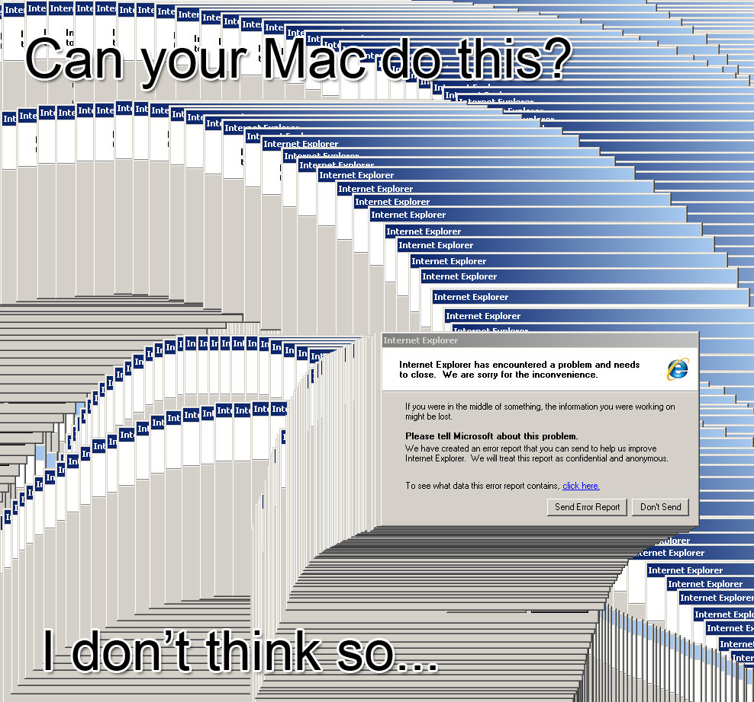
Remember when ?
When messing with locks, you can run a program with no errors but nothing shows up on your screen.
Why ?

Slide 20
OVERVIEW DIAGRAM
DeadLock
Liveness
LiveLock
Starvation
Threads waiting for each other
A Stalemate
Program doesn’t exit, and its not in an infinite loop
Coming soon

Slide 21
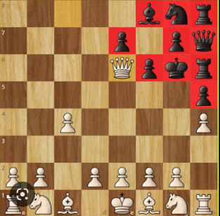
Resources are available but no progress can be made.
The game is declared a draw

Slide 22
LiveLocks
Imagine we have a mutable int X
T1 :
Do {
Sync(X){
X++;
R= Read(X);
}
} while(R<2)
T2 :
Do {
Sync(X){
X--;
R= Read(X);
}
} while(R>-2)

Slide 23
LiveLocks
Congrats you just created your first LiveLock
T1 :
X = 0
X = 1
X = 0
X = 0
X = 1
T2 :
X = 0
X = -1
X = -1

Slide 24

Starvation in Computer Science

Slide 25
Starvation
Imagine we have a webserver having access to 100 sockets (S1, … S100)
T1 :
Do {
IN1 = S1.Readline();
Print(IN1);
} while ( 1 )
…
T100 : <- Starves (never executes)
Do {
IN100 = S100.Readline();
Print(IN1);
} while ( 1 )

Slide 26
The dining philosophers
Chopsticks edition

Slide 27
Any Volunteers ?

Slide 28
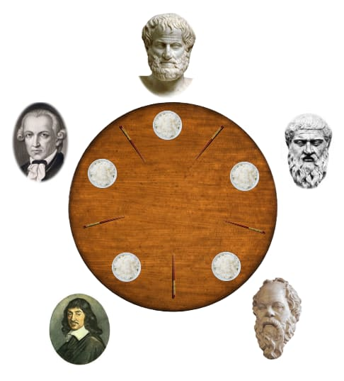
B
C
A
E
D

Slide 29
PROCESS
Step 1
Step 2
Step 3
Step 4
Think
Pick up chopsticks
Eat
Put down chopsticks

Slide 30

Solution 1 :
Problem
Using structured locks
Avoiding starvation

Slide 31
Proposition 1 : Structured locks
While ( 1 ) {
Think();
Sync(Left){
Sync(Right){
Eat();
}
}
}
What could go wrong here ?

Slide 32
Problem :
While ( 1 ) {
Think();
Sync(Left){
Sync(Right){
Eat();
}
}
}
What if everyone is thinking at the same time time ? -> DeadLock

Slide 33
Proposition 2 : Unstructured locks
While ( 1 ) {
Think();
C1 = TryLock(Left)
If (!C1) continue;
C2 = TryLock(Right)
If (!C2) continue;
Eat();
// no blocking operation => no deadlocks right ?
What could go wrong here ?

Slide 34
Proposition 2 : Unstructured locks
While ( 1 ) {
Think();
C1 = TryLock(Left)
If (!C1) continue;
C2 = TryLock(Right)
If (!C2) {
Release(C1)
continue;
}
Eat();
We go into a LiveLock when we don’t release C1

Slide 35
Proposition 3 :
//Run Thread E first :
// E picks up Left then right
While ( 1 ) {
Think();
Sync(Left){
Sync(Right){
Eat();
}
}
}
What could go wrong here ?

Slide 36
Proposition 3 :
//Run Thread E first :
// E picks up Left then right
While ( 1 ) {
Think();
Sync(Left){
Sync(Right){
Eat();
}
}
}
// What could go wrong here ?

Slide 37
Proposition 3 :
//Run Thread E first :
While ( 1 ) {
Think();
Sync(Left){
Sync(Right){
Eat();
}
}
}
// Starvation
This is more complex problem to address and an advanced topic in OS using a Synchronization primitive called Semaphores

Slide 38
03
Actors

Slide 39

Actor
Message[] MailBox
LocalState Count
Method getAndAdd()

Slide 40
Message 1
Message 2
Message 3
Print Actor
(receives and prints messages)

Slide 41
Writing concurrent programs with actors
//Making isolation the default in a higher programming model
PrintActor(s) {
if(s==“\n”) exit();
else print(s)
}
PrintActor.start();
/*Once the process is created and started, it’s in reactive mode, it prints the messages it receives kind of like a callback*/
//Can you identify the problem here ?

Slide 42
Message from : Actor A
Message from : Actor B
Message from : Actor C
Print Actor

Slide 43
A : “Hello”
B : “World”
C : “!”
Print Actor

Slide 44
This is an inherent problem in concurrent programs called non-determinism:
With determinism meaning same input always results in the same output

Slide 45
Algorithms you can implement :
First Come First Serve (FCFS) scheduling.
Shortest job next (SJN) scheduling.
Priority scheduling.
Shortest remaining time.
Round Robin (RR) scheduling…

Slide 46
Message 1
Message 2
Message 3
Listener
Filter lower case
PrintActor

Slide 47

Actors
In the real world

Slide 48
The Sieve of Eratosthenes Algorithm
Sieve of Eratosthenes is a simple and ancient algorithm used to find the prime numbers up to any given limit.

Slide 50
[2,3,4,5,6,7 … 117,118,119,120]
Filter Mult(2)
PrintActor
[3,5,7… ,119]
Filter Mult(3)
Each actor (process) is dynamically created and started by the previous one (parent or fork)
[5,7… ,116,118,119]

Slide 51

ASSIGNMENT
There are no assignements we all have something better to do in life
___

Slide 52
THANKS!
You can find the ppt and code @
https://cellardoor.info/gdsc-concurrency

